Slide 1
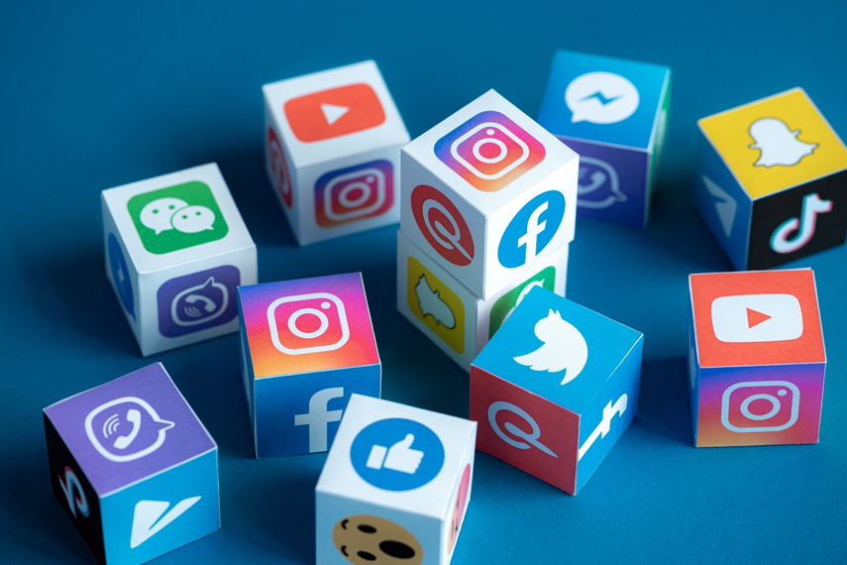
Homework-12
Social Media Advertising & Analytics
Prepared by Nazia Rothy

Slide 2
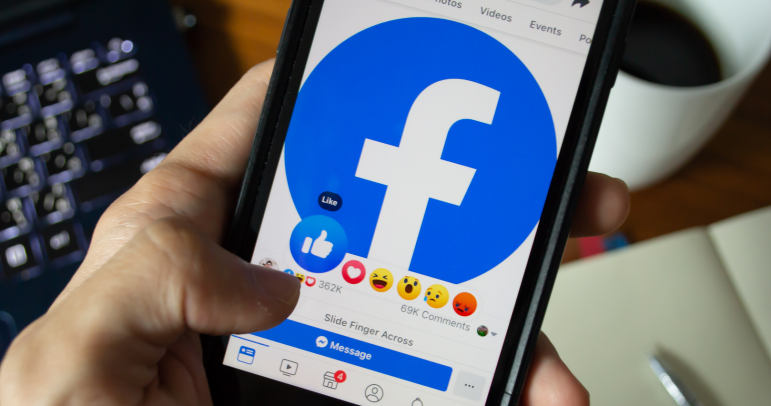
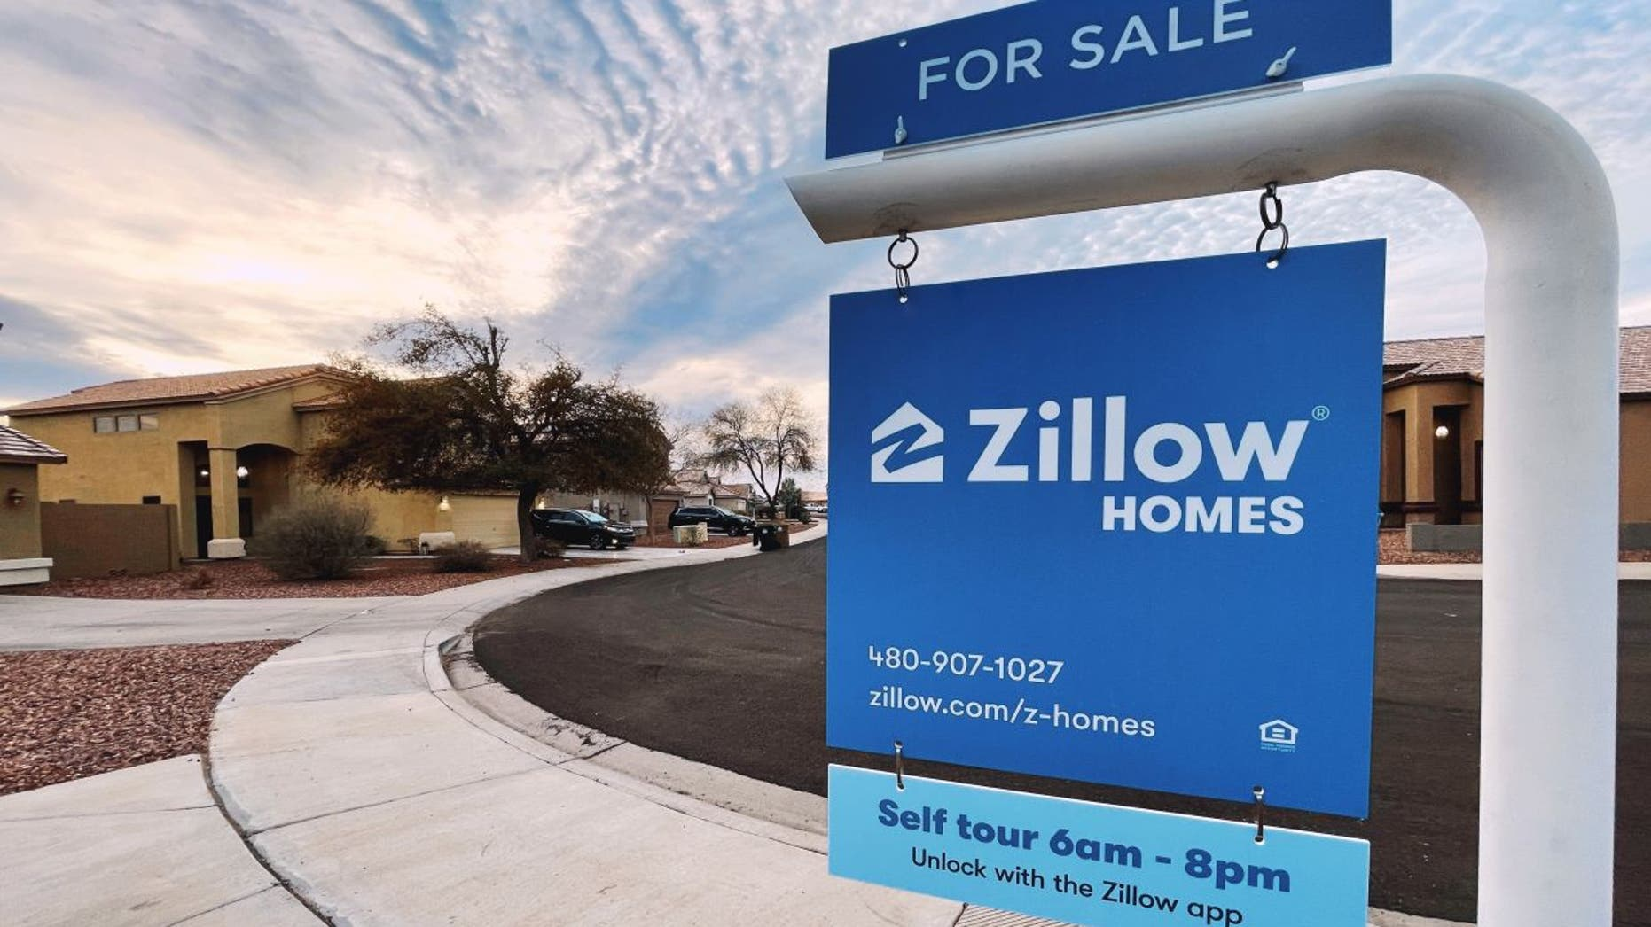
Reasons Behind to choose Facebook for “Zillow”
Facebook ads assist in customer acquisition, engagement and boost brand awareness.
Facebook ads help in increasing revenue, sales, and leads as it has a large audience segmentation.
The benefits of Facebook ads are measurable. As a result, we will be able to track the number of impressions, clicks, and conversions.
It is easy to select audience characteristics on the Facebook network. We can filter results based on relationships and behavior, which includes recent purchases and life events.
Zillow can incorporate client emails into Facebook ads campaign, making Facebook the greatest platform for remarketing clients.
Facebook is one of the most popular smartphone apps available today. So, Zillow can reach target audiences through the devices they use every day.

Slide 3


Reasons Behind to choose Twitter for “KIMPTON”
Twitter is the only social network where brands and consumers have an equal playing field and limitless channels of clear, concise communication.
KIMPTON may target clients on Twitter’s industry-specific parameters because the company provides a variety of appealing corporate deals and offers.
Twitter can help KIMPTON to boost brand recognition across key professional audiences.
Twitter can generate conversations that can lead to more new business possibilities for KIMPTON.
KIMPTON provides various business deals and offers for professionals, travelers, therefore Twitter can be an excellent platform for them to reach the targeted audience to the worldwide.
3

Slide 4

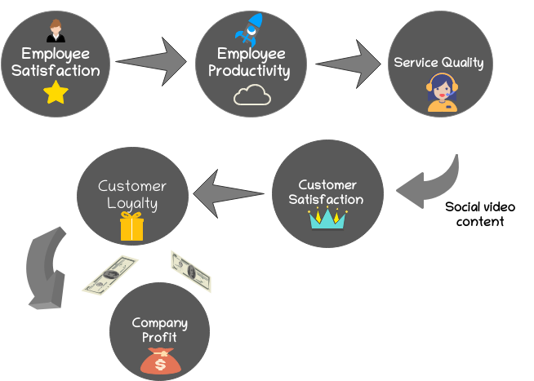
Role of the Ads for Contentment of Employees and Customers
Facebook sponsored ads offer additional functionality and placement possibilities for each business As a result, boosted postings make it simple to target a specific audience, budget, and campaign duration that is more conducive to employee satisfaction.
Social media ads
Video content, especially social videos in both social media, is very effective for attracting and engaging Generation Z and Millennials because it connects audiences on a personal and emotional level with the brand.
Twitter ads link businesses with their target consumers, driving traffic, generating quality leads, and building brand loyalty.

Slide 5
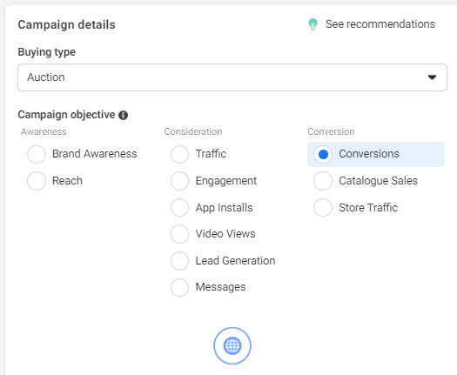
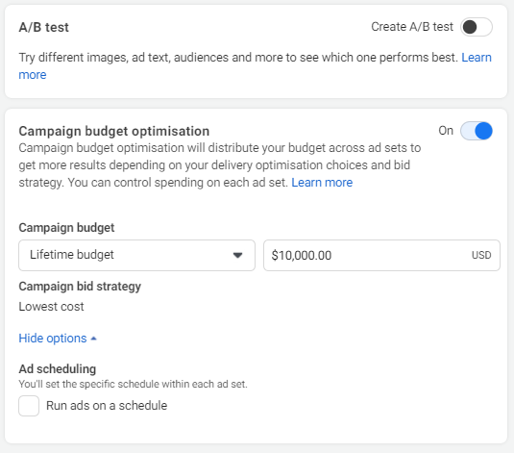
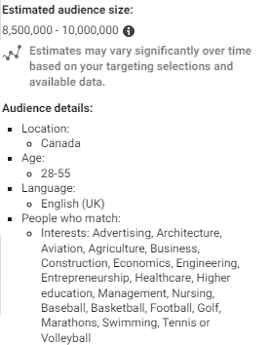
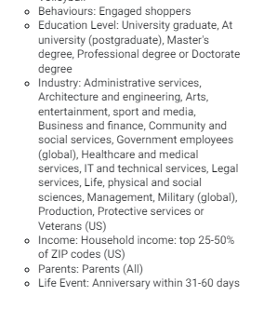
Campaign Parameters
Campaign Objective:
Audience Targeting: Create Saved Audience
I’ve selected the objective-Conversions because they can persuade those who are interested in the business to buy or utilise the products or services. Facebook is the best channel for a greater audience to see the campaign about Zillow's buy, sell, or rent inventory, as well as other services, and gather more information.
Age: 28-55 Years (potential age to purchase)
Location: Canada (although Zillow has USA inventory)

Slide 6
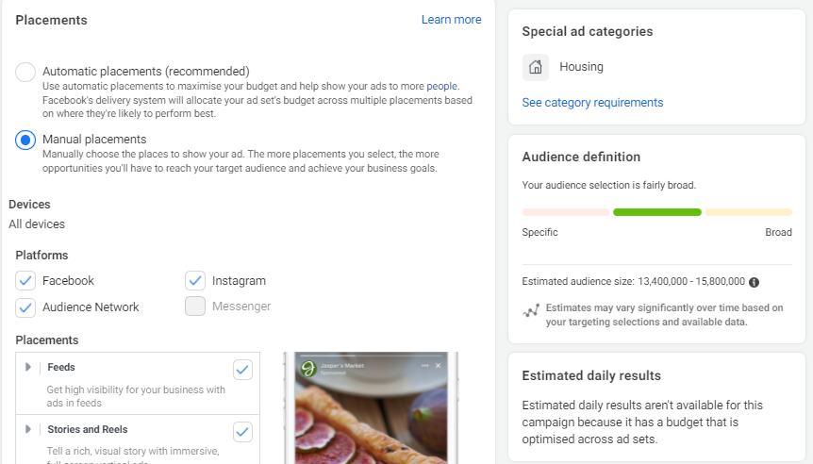
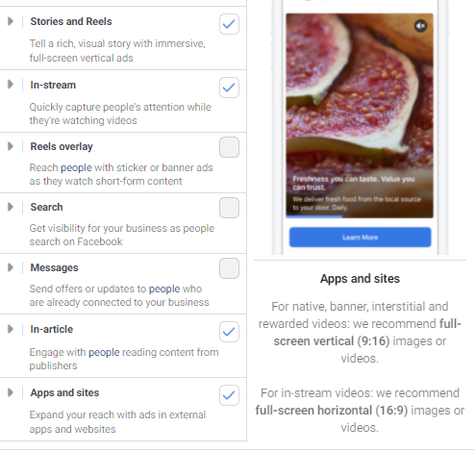
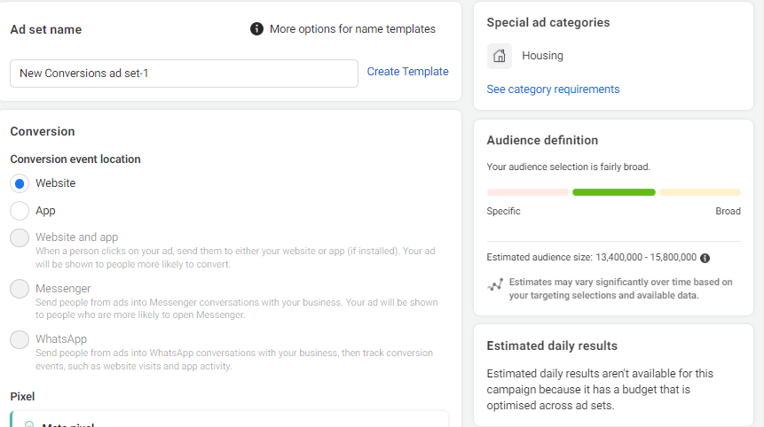
Campaign Parameters(Cont.)
Placements:

Slide 7
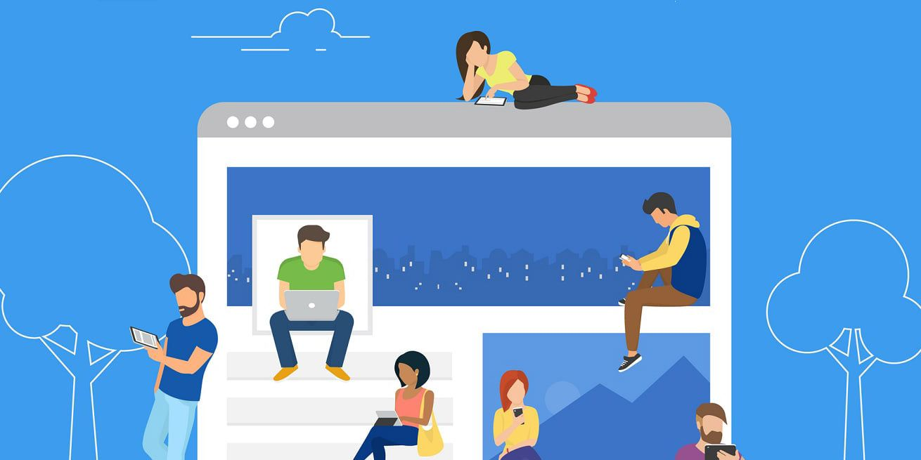
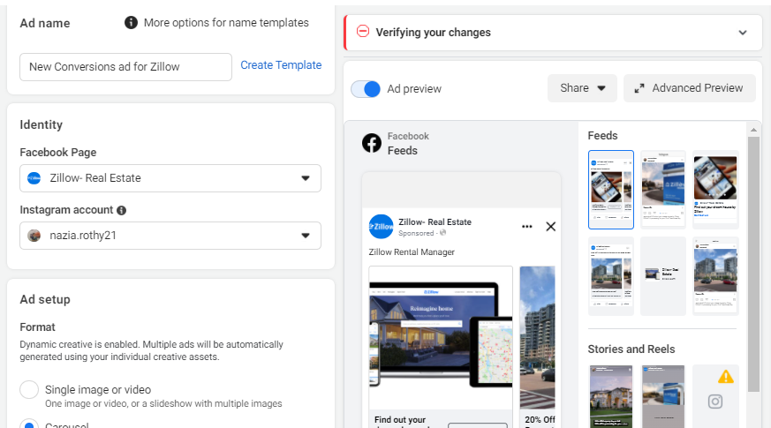
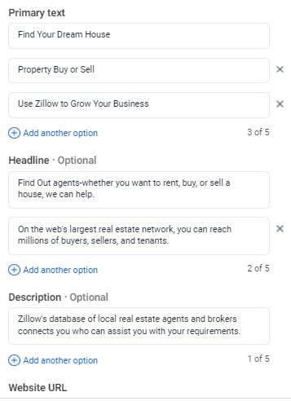
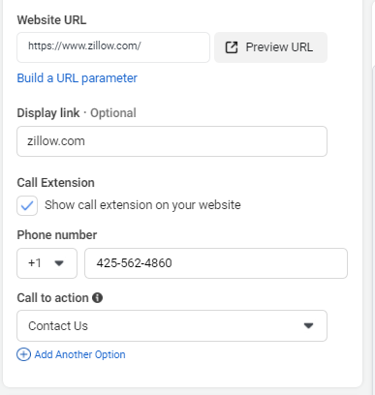
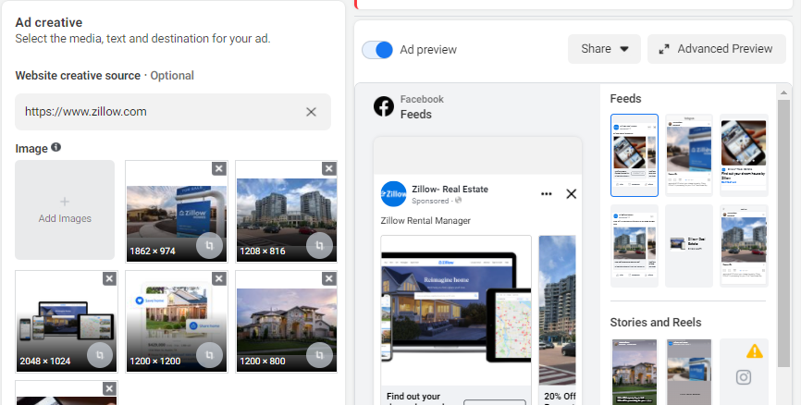
Campaign Ads Creation
Ad Format: Multiple Images and one video
Reasons for Images: Images that symbolize the company's commitment to providing high-quality service to its customers. These pictures are also linked to someone's feelings while buying or selling property.
Reason for video: This video explains in detail the property purchase tactics for customers that are quite beneficial.

Slide 8
The significance of social Media-specific Ads and Post Copy
Way to express Love of employees & customers about the company
The ad creative tells a story of why employees and customers love the company, where Zillow and its partners provide clients with an on-demand experience for selling, buying, renting, and financing with transparency, as displayed in their photos. Zillow's pictures are more dynamic and descriptive of the buyer or seller's emotions.
Zillow’s Ads on Facebook Platform:
The ad's wordings are clear and straightforward, making it easily understood by the audience. For Zillow's advertisements, Facebook is the ideal platform because the audience is huge and the targeted age range is variable. In the advertisements, I placed the most essential information at the beginning and deliver it to the audience in a clear and concise manner.
Zillow is well-established in the real estate industry, and they are focusing their efforts on meeting the specific demands of their consumers in order to boost the customer experience they deliver. The goal of Zillow's personalised ads is to offer experiences that communicate directly to each unique client.

Slide 9
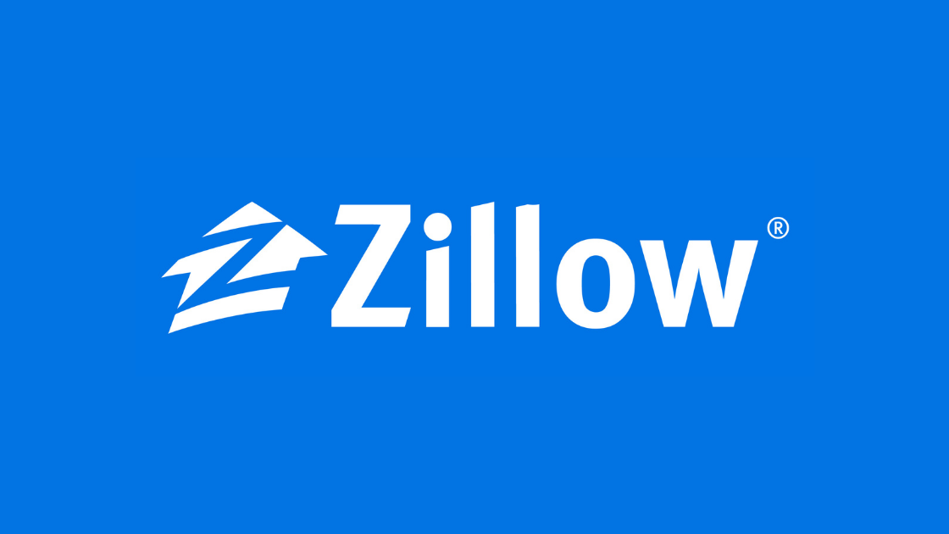
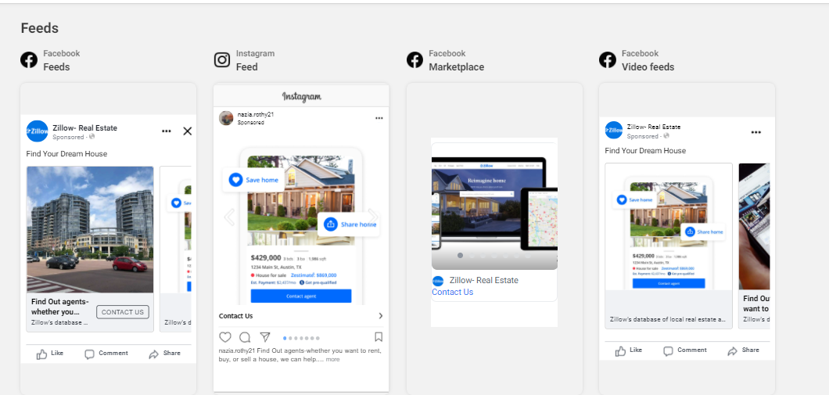
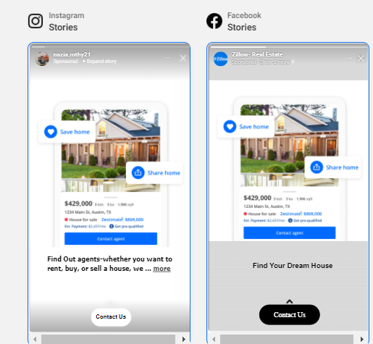
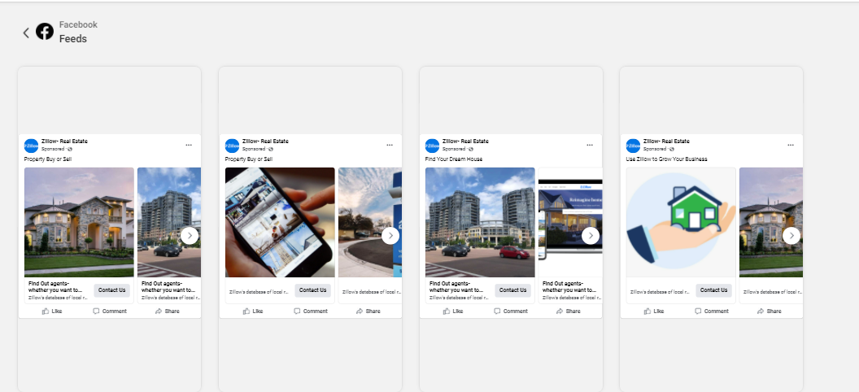
Campaign Preview
Feeds (Mobile View)
Stories
Desktop View

Slide 10
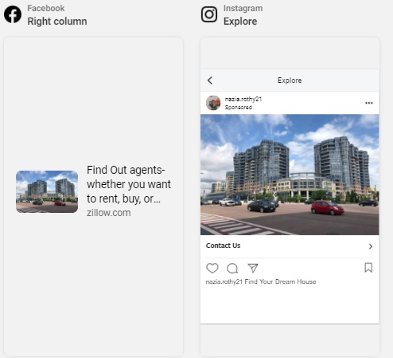
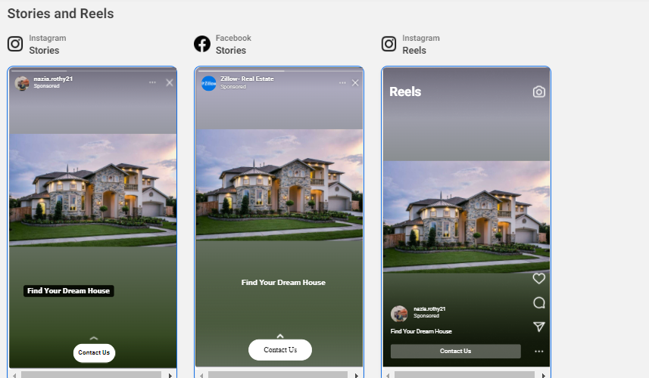
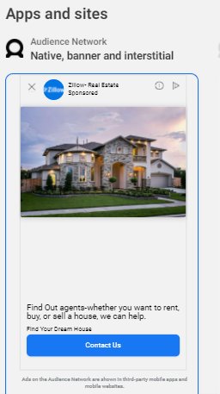
Campaign Preview(Cont.)
Facebook (column) & Instagram(Explore)
Stories & Reels
Apps & sites

Slide 11
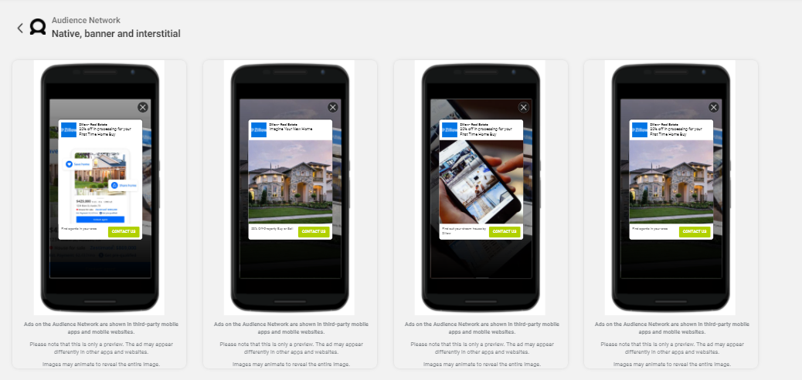
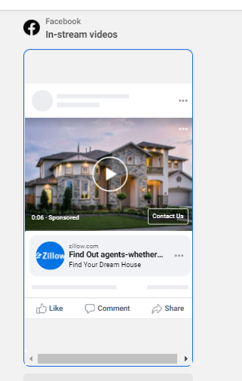
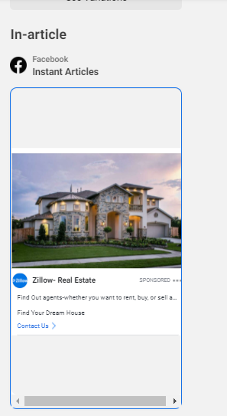
Campaign Preview(Cont.)
Audience Network
In-stream
In-article

Slide 12
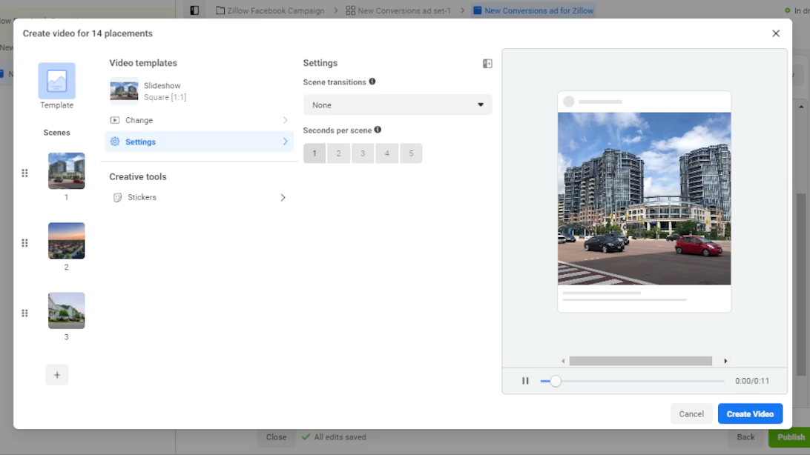
Ads Visualization
Links:
https://drive.google.com/file/d/1i7sDwPL3r56h492UFazzQFXw7rUTg9QD/view?usp=sharing

Slide 13

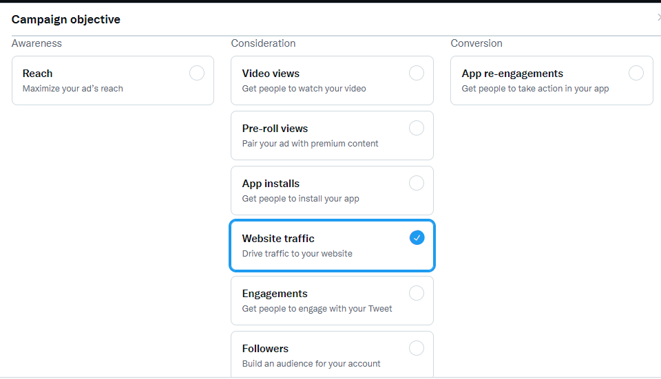
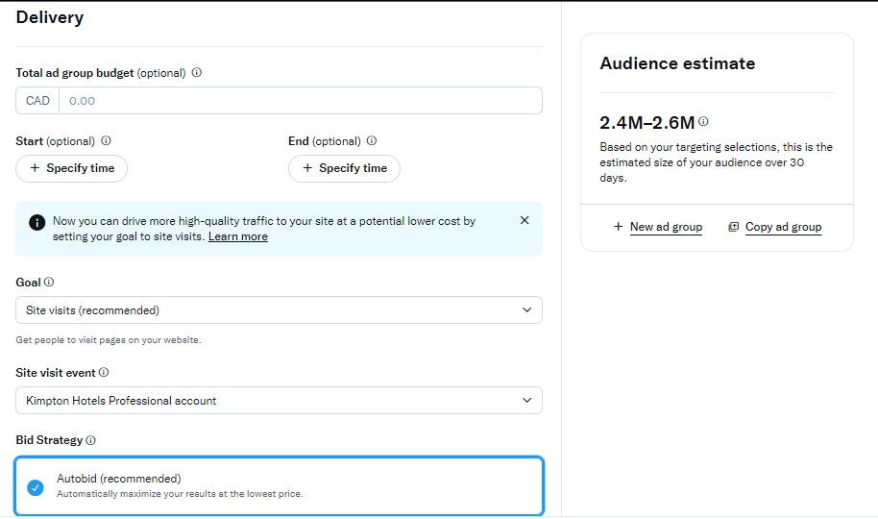
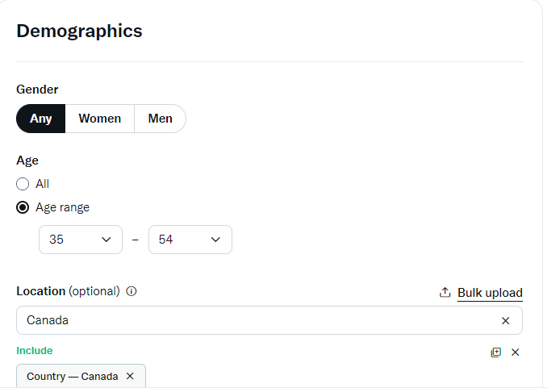
Campaign Parameters for KIMPTON
Campaign Objective:
Audience Targeting:
I’ve selected the objective-Website Traffic for Kimpton which is in the consideration funnel because the more visitors visit website, company will get the more prospective clients. Although Kimpton is a well-known brand in the hospitality business, the campaign's goal is to attract more potential consumers.
Age: 35-54 Years (Mid & high level professionals)
Location: Canada

Slide 14
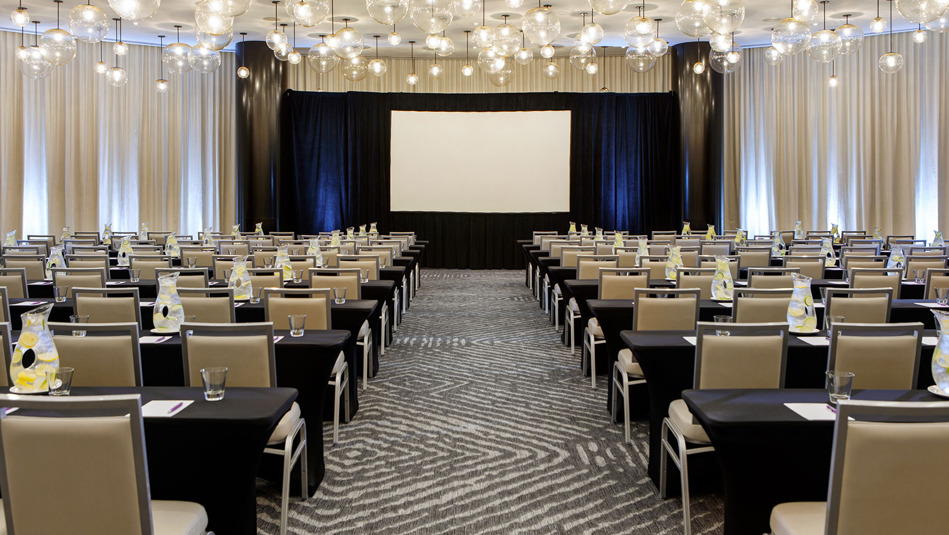
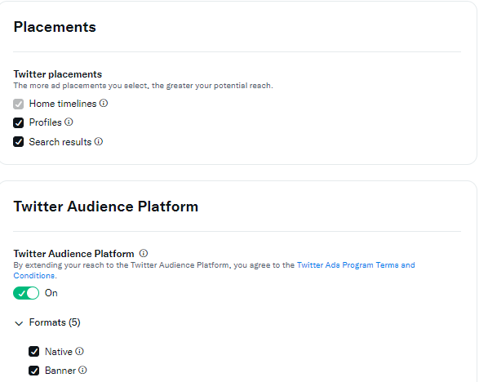
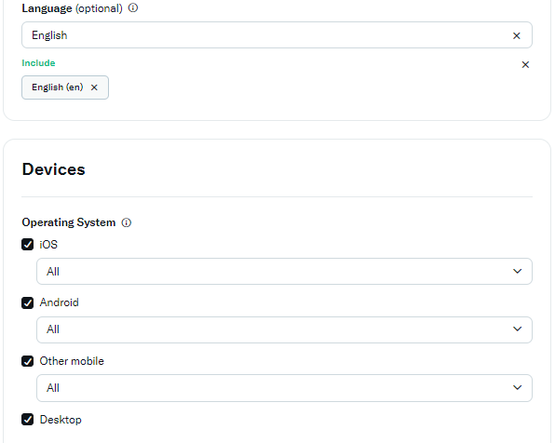
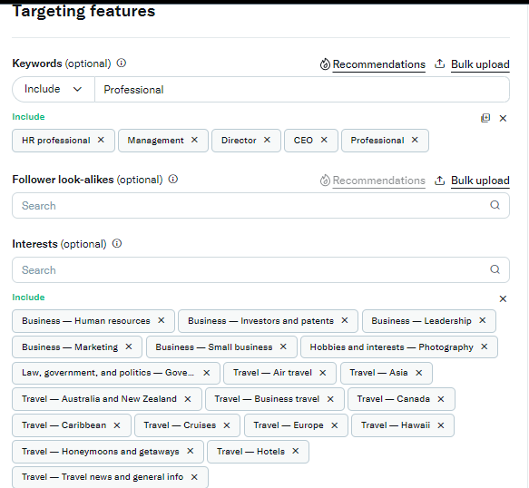
Campaign Parameters(Cont.)
Placements:
Devices:
Audience Targeting Feature

Slide 15

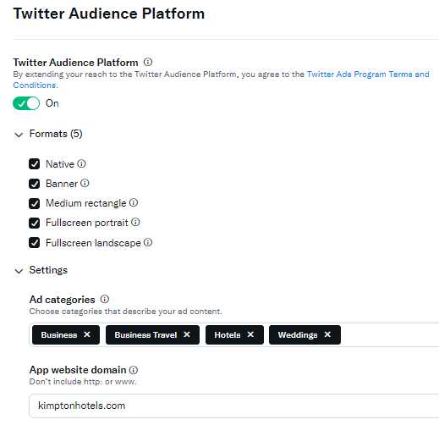
Campaign Parameters (Cont.)
Audience Platform

Slide 16

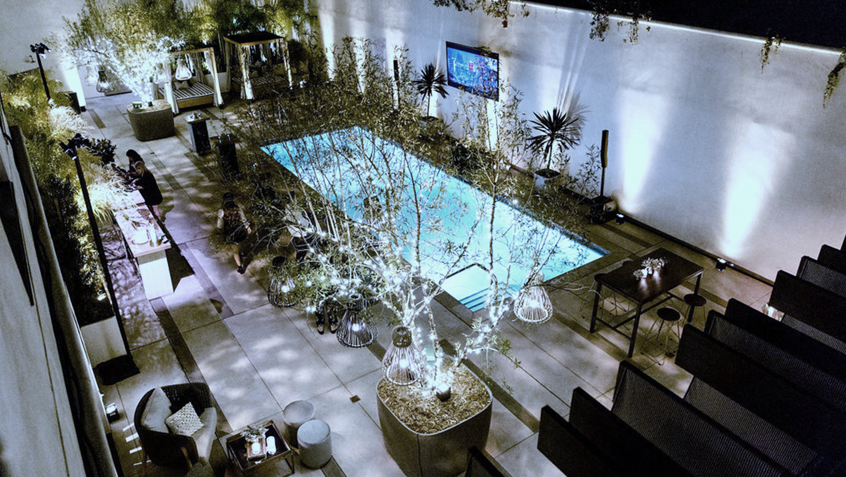
Campaign Ads Creation
Ad Format: Images
Reasons for Images: Images that represent the company's dedication to providing excellent experience to its clients. These images illustrate Kimpton's wedding venues, event planning, and overall organizational competence.
The ad creative narrates a story about why employees and customers love the company, which is the leader in individually designed and positioned hotels and restaurants in the hospitality industry, and moreover, Kimpton creates memories for a lifetime of clients' most special day-the wedding day.
The Significance of Social Media-specific Ads and Post Copy
Kimpton’s Ads on Twitter:
Customers are informed about a company's products and services using documents, text, photos, manuals, and other business tools. As a result, I included photos from Kimpton's key businesses, such as event organizing, development & management services. Customers will not be able to pick up and handle the company's products, therefore images can be best way to serve the purpose.
Twitter is a platform where businesses can reach out to customers all over the globe with ads that are both cost-efficient and very beneficial in reaching out to their target consumers.

Slide 17
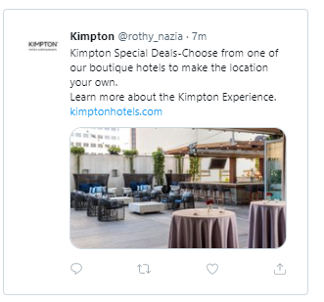
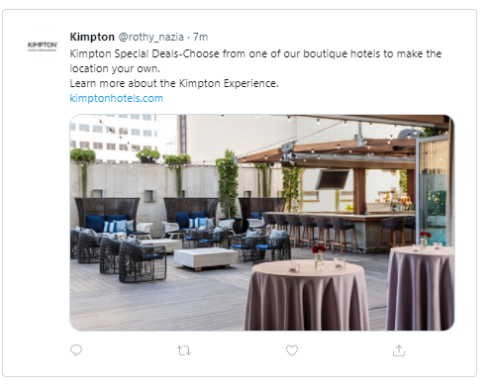
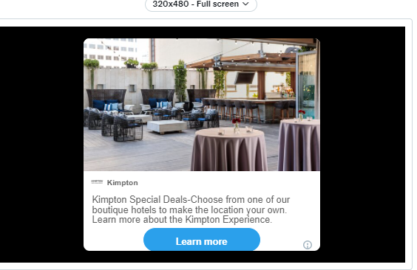
Campaign Preview (Single Ad)
Mobile Preview
Desktop Preview
Audience Network

Slide 18
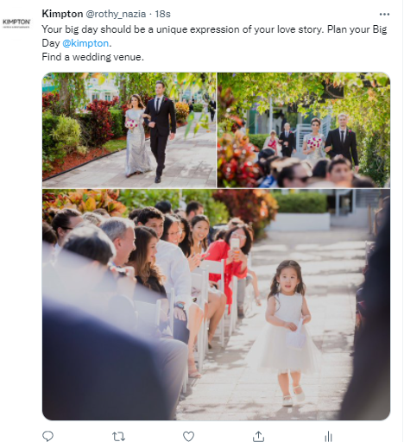
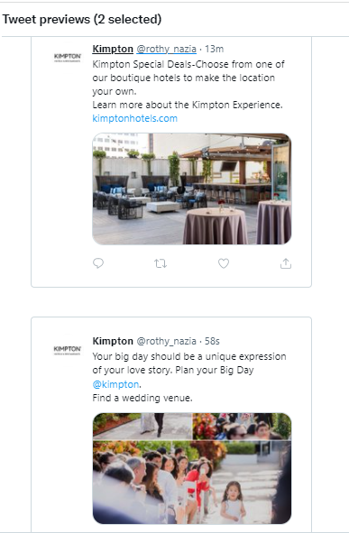
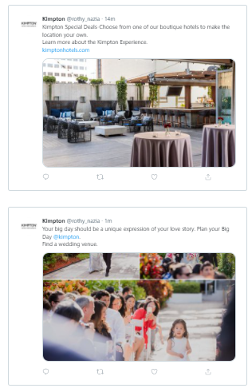
Campaign Preview(Cont.)
Tweet in Homepage
Mobile Preview
Desktop Preview

Slide 19
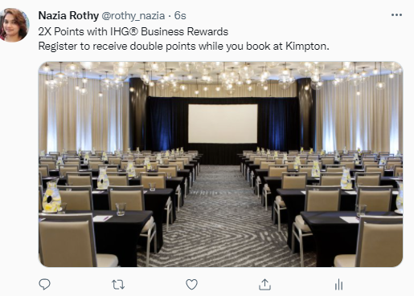
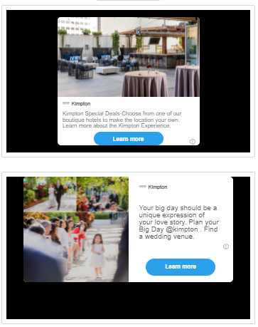
Campaign Preview(Cont.)
Tweet in Homepage
Audience Network

Slide 20
Student Activity: 12.5.10 Charts Cheat Sheet
https://docs.google.com/spreadsheets/d/1eHqJpYU9BGVddte-J2tCOsplJmEgD5IaW_4XfsY3ypM/edit?usp=sharing

Slide 21
THANK YOU!

